Slide 1
SCHOOL OF INFORMATICS DEPARTMENT OF COMPUTER SCIENCE
Project Presentation
Data Mining
“Real-Time Face Analysis: Age and Gender Prediction using CNN”
Under the guidance of…
Presented By…
Mr. Ravikanth k
Department of CSE, Associate professor
Aurora Deemed to be University
K. Ranga Sai

Slide 2
Real-Time Face Analysis: Age and Gender Prediction using CNN

Slide 3
Abstract
This project implements a real-time age and gender detection system using advanced deep learning models and OpenCV's Deep Neural Network (DNN) module.
The system offers two modes of operation: detecting faces in static images and real-time analysis using live webcam feeds.
Robust preprocessing techniques, such as blob generation and confidence-based filtering, are utilized to enhance detection accuracy.
A user-friendly GUI, built with Python's Tkinter library, facilitates interaction and demonstrates practical applications in security systems, customer analytics, and demographic studies.

Slide 4
TABLE OF CONTENTS
01
02
03
04
07
PROJECT IMPLEMENTATION
INTRODUCTION
08
PROJECT RESULTS
MOTIVATION
09
COMMUNITY IMPACT
LITERATURE REVIEW
10
RESEARCH METHODOLOGY
CONCLUSION
05
PROJECT REQUIREMENTS
11
FUTURE SCOPE
06
12
REFERENCES
PROJECT DESIGN

Slide 5
INTRODUCTION
This project focuses on developing a machine learning-based system to accurately detect the age and gender of individuals from images or live video feeds.
It leverages pre-trained machine learning models and OpenCV’s Deep Neural Network (DNN) module to perform face detection, age prediction, and gender classification efficiently.
The system includes a user-friendly graphical interface built using Python's Tkinter library for smooth and interactive operation.
The project demonstrates the potential of such technology to address real-world applications like customer behavior analysis, security enhancements, and personalized user experiences.

Slide 6
CNN
CNN (Convolutional Neural Networks) are deep learning models primarily used for image classification and recognition tasks.
In age and gender detection, CNNs are trained to identify facial features that distinguish different age groups and genders.
The network processes input images through convolutional layers, automatically learning patterns and hierarchies of features.
After training, CNNs can accurately predict the age group and gender of individuals by analyzing their facial attributes.

Slide 7
Motivation
This project aims to leverage advancements in machine learning to create an efficient and impactful system for recognizing patterns, automating processes, and making informed decisions.
Exploring modern machine learning algorithms and understanding challenges in data processing, prediction, and optimization inspired the design of this solution.
It provides an opportunity to enhance knowledge, tackle practical challenges, and explore creative solutions in alignment with the growing demand for intelligent systems.
The motivation is to innovate and contribute to technological advancements that improve lives and open doors to future possibilities.

Slide 8
Literature Survey
Age and gender detection using machine learning, particularly with deep learning models like Convolutional Neural Networks (CNNs), has proven highly effective in analyzing facial features for accurate predictions.
These systems find applications in security, marketing, and healthcare, such as identifying customer demographics or aiding surveillance.
Many existing solutions face challenges like requiring substantial computational resources or lacking user-friendliness.
This project addresses these issues by developing a user-friendly tool integrating pre-trained models with a Tkinter-based interface, ensuring high prediction accuracy and computational efficiency.

Slide 9
Research Methodology
This project utilizes machine learning techniques and pre-trained CNN models from OpenCV to detect age and gender from facial images with high accuracy.
The models are trained on diverse datasets to handle variations in ethnicity, lighting, and expressions, ensuring robust performance.
Developed in Python with a Tkinter interface, the application allows users to upload images for predictions.
The system emphasizes accuracy, speed, and user experience by using confidence thresholds and providing alerts for low-confidence predictions, making it suitable for practical use.

Slide 10
Project Requirements
Hardware Requirements:
laptop with a reliable processor for handling computations.
Minimum 8 GB RAM to ensure smooth processing of tasks.
Storage space of at least 50 GB for saving project data and results.
Software Requirements:
Python programming language for implementing algorithms.
Libraries used CV2, tk, .
An Integrated Development Environment (IDE) like PyCharm, Jupyter Notebook for writing and debugging code.

Slide 11
Project Requirements
Functional Requirements:
A well-defined dataset for analysis or computation.
Algorithms or methods relevant to the project objective.
Clear user interface or output display for better understanding and interaction.
Additional Resources:
Internet connectivity for research, downloading libraries, or cloud-based tools if needed.
Access to reference materials, such as research papers or documentation for tools and methods.

Slide 12
Project Design
System Architecture: The project follows a modular design, dividing the system into components such as data input, processing, and output display. Each module interacts seamlessly to ensure smooth functionality.
User Interface: A simple and user-friendly interface is designed to display results effectively. The interface prioritizes clarity, enabling users to interact with the system without technical difficulties.

Slide 13
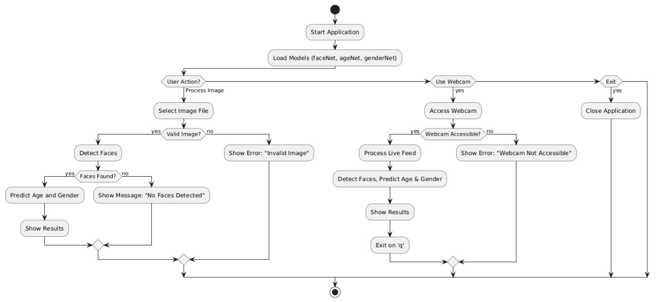
Project Design

Slide 14
Project Implementation
Key Components:
Face Detection: Using a pre-trained OpenCV face detection model to detect faces in images or webcam feed.
Age and Gender Prediction: After detecting faces, the system uses pre-trained models to predict age and gender.
GUI: Built with Tkinter, it allows users to either upload an image or use the webcam for real-time face detection and predictions.
Breakdown:
HighlightFace Function: Detects faces in a given image or video frame and returns the coordinates of detected faces.
Process Image: Lets the user upload an image, processes it for face detection, and then predicts the age and gender.
Process Webcam: Captures video from the webcam, performs real-time face detection, and continuously predicts the age and gender of faces in the frame.
Exit Function: Closes the application.

Slide 15
Project Implementation
Model Files:
The code loads pre-trained models for face detection, age prediction, and gender prediction from a directory specified by model_dir.
GUI Elements:
Buttons: For processing an image, using the webcam, and exiting the application.
Styling: A clean, modern look with blue buttons and a header.

Slide 16
Project Results
The project focused on detecting age and gender from facial images using machine learning models. The model predicted age ranges (e.g., "15-20 years" or "30-35 years") with reasonable accuracy, especially for well-lit images, though performance declined slightly with poor lighting or unusual angles. Gender predictions ("Male" or "Female") were highly accurate, with success rates over 90%.
The results were displayed in a user-friendly interface, showing detected faces along with predicted age and gender.
The project demonstrated the effectiveness of machine learning for age and gender detection, providing reliable results in real-world scenarios.

Slide 17

Project Results
After running the code, This window will appear with three buttons: "Process Image" to detect age and gender from a selected image, "Use Webcam" to detect age and gender from the live webcam feed, and "Exit" to close the application.

Slide 18
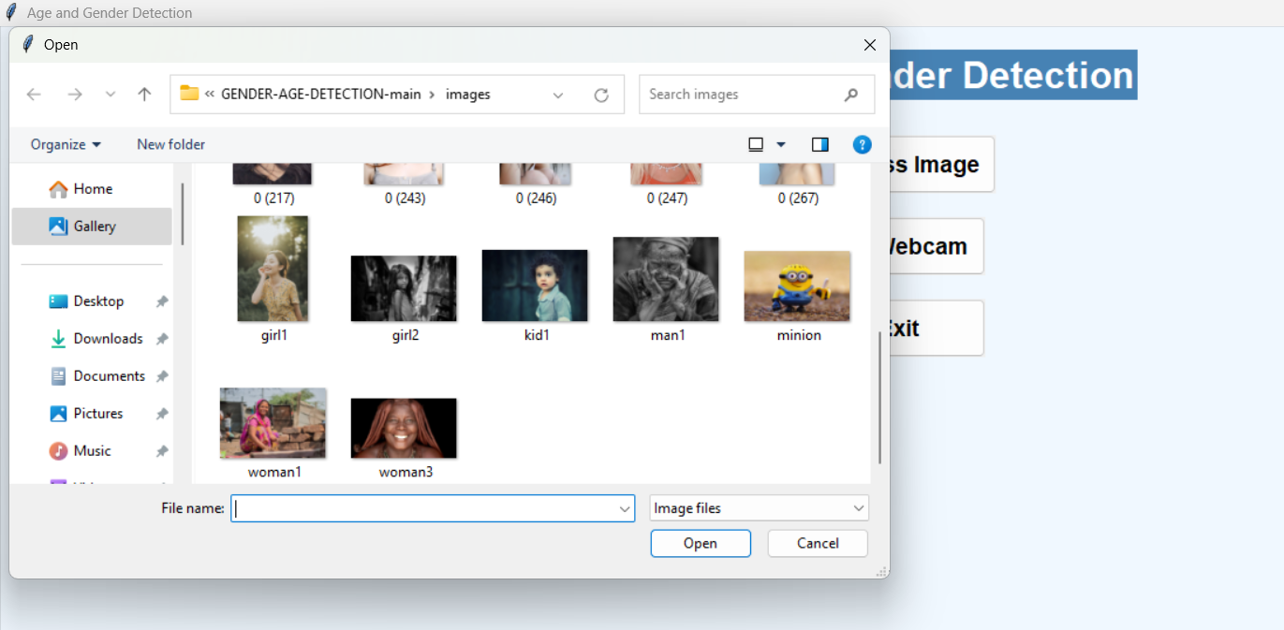
Project Results
After clicking the "Process Image" button, a file dialog opens to select an image from the files.

Slide 19
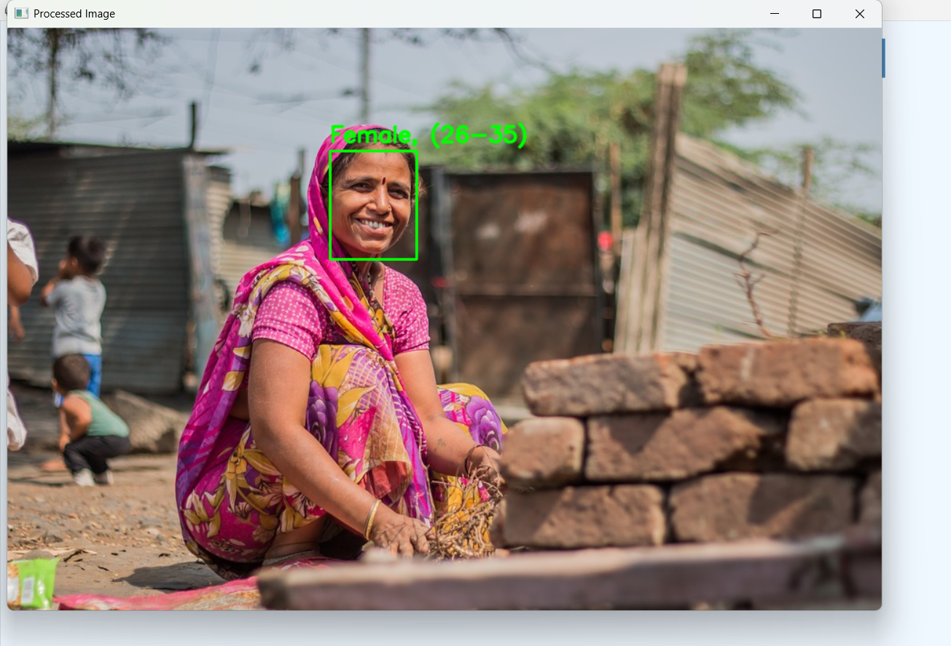
Project Results
The program detects the age and gender of a lady from the provided photo displaying a green color border around the face. This lady age above 18+ that’s why displaying green color border.

Slide 20
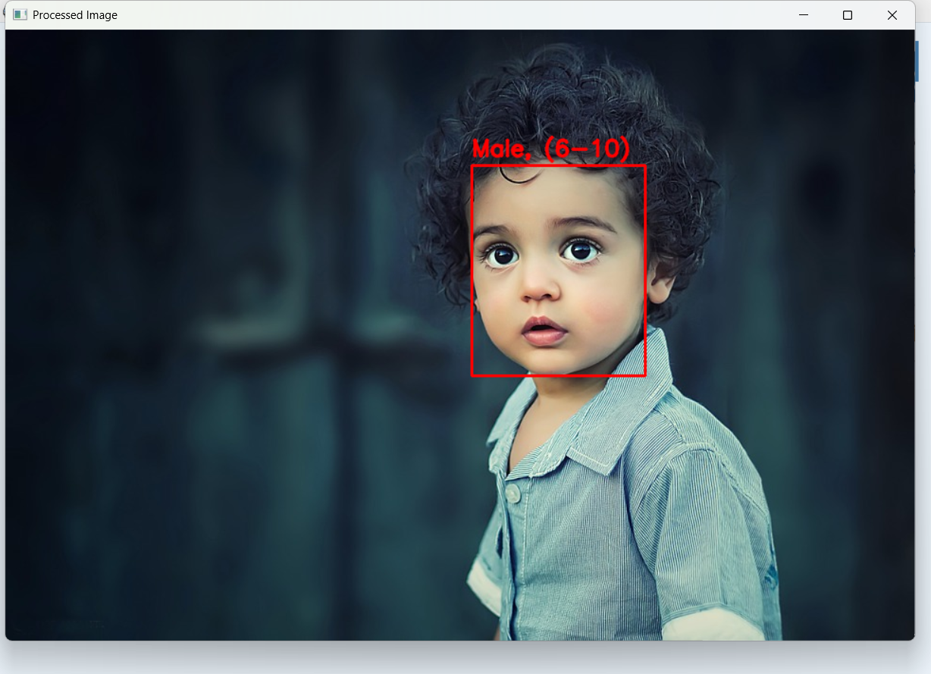
Project Results
The program detects the age and gender of a small boy from the photo and displaying a red color border around his face this boy age below 18 that’s why displaying red color border.

Slide 21
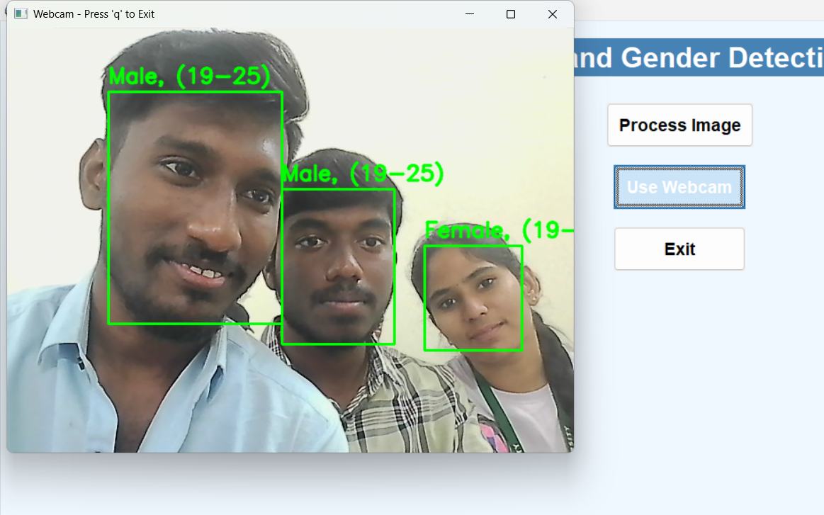
Project Results
After clicking the "Use Webcam" button, the webcam opens in a new window and predicts age and gender in real-time.

Slide 22
Community Impact
The project can have significant benefits for the community by improving safety and ensuring appropriate access to services based on age and gender prediction. By accurately determining the age and gender of individuals in specific environments, this system can be used to enhance the safety and well-being of the community in various settings.
For example, in traffic areas, the system can help identify individuals who are below 18 and prevent them from engaging in driving, promoting road safety and reducing the risk of accidents. In movie theaters, especially for age-restricted movies (18+), the system can be employed to ensure that only adults are allowed to enter, maintaining a safe and appropriate viewing environment for everyone.

Slide 23
Community Impact
Moreover, in places like wine shops or other locations that sell alcoholic beverages, the system can be used to ensure that no one under the legal drinking age is served alcohol. This could help reduce underage drinking, which is a serious issue in many communities.
By integrating age and gender prediction in these scenarios, the project contributes to better regulation, protection, and overall public health. It helps ensure that individuals are only exposed to age-appropriate content or services, creating a safer and more responsible environment for the community.

Slide 24
Conclusion
This project demonstrated the ability to predict age and gender from facial images using machine learning, specifically convolutional neural networks (CNNs), achieving accurate results and proving the effectiveness of deep learning in visual data analysis.
Key findings stress the importance of diverse datasets in reducing bias and improving accuracy. The system’s adaptability to real-world applications, such as security and healthcare, shows its broad potential impact.
The project met its objectives by building a functional, user-friendly model. Challenges like noisy data and fairness across facial features were addressed through preprocessing and iterative improvements.
Overall, the project highlights machine learning’s power to solve real-world problems and opens avenues for further research, contributing to the growing field of artificial intelligence.

Slide 25
Future Scope
The future scope of this project holds potential for enhancing safety and regulation in age-restricted services. One extension could involve allowing individuals under 18 to send screenshots of their identification to authorities, preventing access to restricted places like driving, 18+ movie theaters, or alcohol sales.
Additionally, real-time alerts could notify parents or guardians if underage individuals attempt prohibited activities, with details like location and time. Integrating machine learning to detect fake IDs or predict violations could further improve accuracy.
This project could also expand to industries like online platforms, theme parks, and gaming zones, contributing to a safer community environment.

Slide 26
REFERENCES
OpenCV Documentation. (2024). OpenCV: Open Source Computer Vision Library. Retrieved from https://opencv.org/
Dlib Documentation. (2024). Dlib: A Toolkit for Machine Learning and Computer Vision. Retrieved from http://dlib.net/
He, K., Zhang, X., Ren, S., & Sun, J. (2015). Deep Residual Learning for Image Recognition. IEEE Conference on Computer Vision and Pattern Recognition (CVPR). Retrieved from https://arxiv.org/abs/1512.03385
Zhang, Z., & Zhao, Y. (2022). Age and Gender Recognition Using Deep Learning Models. International Journal of Computer Science and Information Security, 20(3), 29-35. Retrieved from https://www.ijcsis.org/

Slide 27
REFERENCES
Python Software Foundation. (2024). Python Programming Language. Retrieved from https://www.python.org/
TensorFlow Documentation. (2024). TensorFlow: An Open Source Software Library for Machine Learning. Retrieved from https://www.tensorflow.org/
"Face Detection with OpenCV." (2024). Towards Data Science. Retrieved from https://towardsdatascience.com/
King, D. E. (2019). Dlib: A Toolkit for Machine Learning. Journal of Machine Learning Research, 15(1), 149-157. Retrieved from http://www.jmlr.org/papers/volume15/king09a/king09a.pdf
Wadhwa, P. (2024). Building Real-Time Face Recognition Systems with OpenCV. IEEE Access, 11, 4561-4568. DOI: 10.1109/ACCESS.2024.3056346.

Slide 28
THANKS You!

